Slide 1
Linear Programming
Sensitivity Analysis

Slide 2
What if there is uncertainly about one or more values in the LP model?
Sensitivity analysis allows us to determine how “sensitive” the optimal solution is to changes in data values.
This includes analyzing changes in:
An Objective Function Coefficient (OFC)
A Right Hand Side (RHS) value of a constraint

Slide 3
Graphical Sensitivity Analysis
We can use the graph of an LP to see what happens when:
An OFC changes, or
A RHS changes
Recall the Flair Furniture problem

Slide 4
Flair Furniture Problem
Max 7T + 5C (profit)
Subject to the constraints:
3T + 4C < 2400 (carpentry hrs)
2T + 1C < 1000 (painting hrs)
C < 450 (max # chairs)
T > 100 (min # tables)
T, C > 0 (nonnegativity)

Slide 5
Objective Function
Coefficient (OFC) Changes
What if the profit contribution for tables changed from $7 to $8 per table?
8
Max 7 T + 5 C (profit)
Clearly profit goes up, but would we want to make more tables and less chairs?
(i.e. Does the optimal solution change?)
X

Slide 6
Characteristics of OFC Changes
There is no effect on the feasible region
The slope of the level profit line changes
If the slope changes enough, a different corner point will become optimal

Slide 7
C
500
400
300
200
100
0
Original
Objective Function
7T + 5 C = $4040
Optimal Corner
(T=320, C=360)
Still optimal
Revised
Objective Function
8T + 5 C = $4360
Feasible
Region
0 100 200 300 400 500 T

Slide 8
C
1000
600
450
0
What if the OFC became higher?
Or lower?
11T + 5C = $5500
Optimal Solution
(T=500, C=0)
3T + 5C = $2850
Optimal Solution
(T=200, C=450)
Both have new optimal corner points
Feasible
Region
0 100 500 800 T

Slide 9
There is a range for each OFC where the current optimal corner point remains optimal.
If the OFC changes beyond that range a new corner point becomes optimal.
Excel’s Solver will calculate the OFC range.

Slide 10
Right Hand Side (RHS) Changes
What if painting hours available changed from 1000 to 1300?
1300
2T + 1C < 1000 (painting hrs)
This increase in resources could allow us to increase production and profit.
X

Slide 11
Characteristics of RHS Changes
The constraint line shifts, which could change the feasible region
Slope of constraint line does not change
Corner point locations can change
The optimal solution can change

Slide 12
Old optimal
corner point
(T=320,C=360)
Profit=$4040
C
500
400
300
200
100
0
Feasible region becomes larger
New optimal
corner point
(T=560,C=180)
Profit=$4820
Original
Feasible
Region
2T + 1 C = 1000
2T + 1 C = 1300
0 100 200 300 400 500 600 T

Slide 13
Effect on Objective Function Value
New profit = $4,820
Old profit = $4,040
Profit increase = $780 from 300 additional painting hours
$2.60 in profit per hour of painting
Each additional hour will increase profit by $2.60
Each hour lost will decrease profit by $2.60

Slide 14
Shadow Price
The change is the objective function value per one-unit increase in the RHS of the constraint.
Will painting hours be worth $2.60 per hour regardless of many hours are available ?

Slide 15
Range of Shadow Price Validity
Beyond some RHS range the value of each painting hour will change.
While the RHS stays within this range, the shadow price does not change.
Excel will calculate this range as well as the shadow price.

Slide 16
Constraint RHS Changes
If the change in the RHS value is within the allowable range, then:
The shadow price does not change
The change in objective function value =
  (shadow price) x (RHS change)
If the RHS change goes beyond the allowable range, then the shadow price will change.

Slide 17
Objective Function
Coefficient (OFC) Changes
If the change in OFC is within the allowable range, then:
The optimal solution does not change
The new objective function value can be calculated

Slide 18
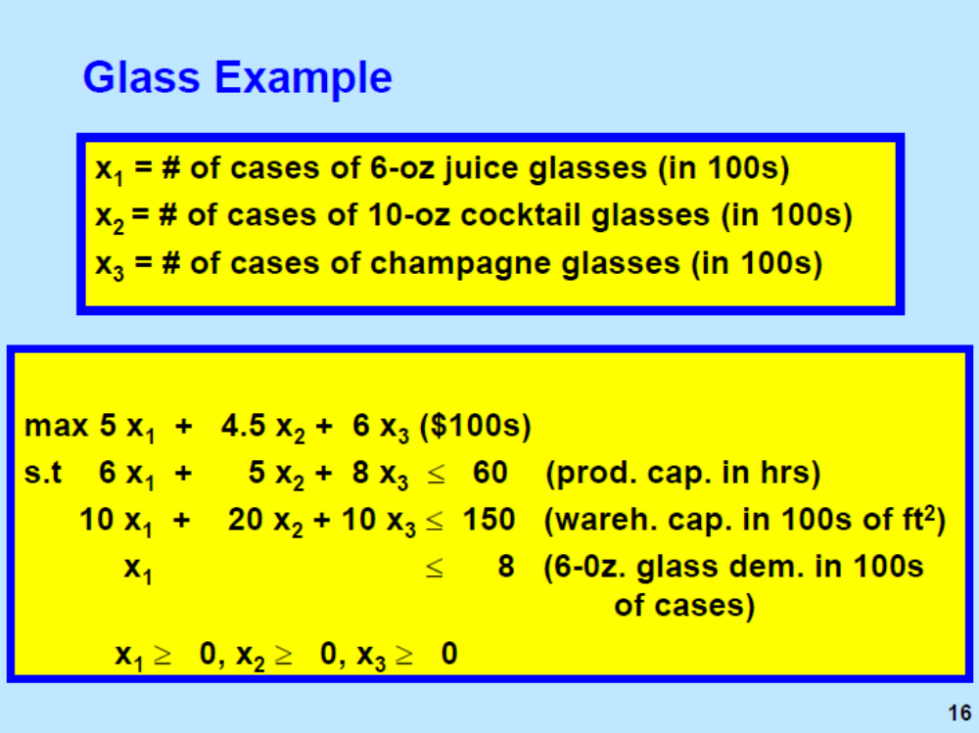


Slide 19
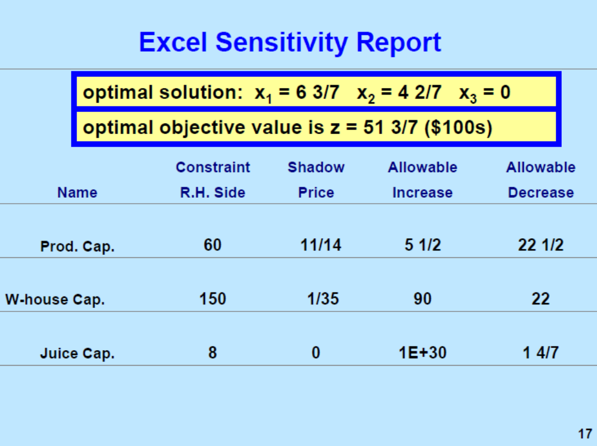

Slide 20
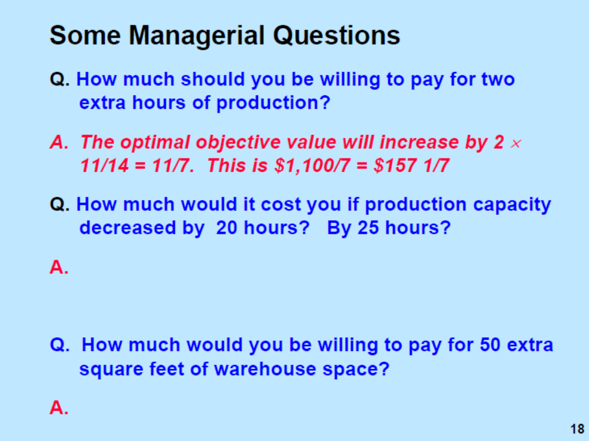

Slide 21
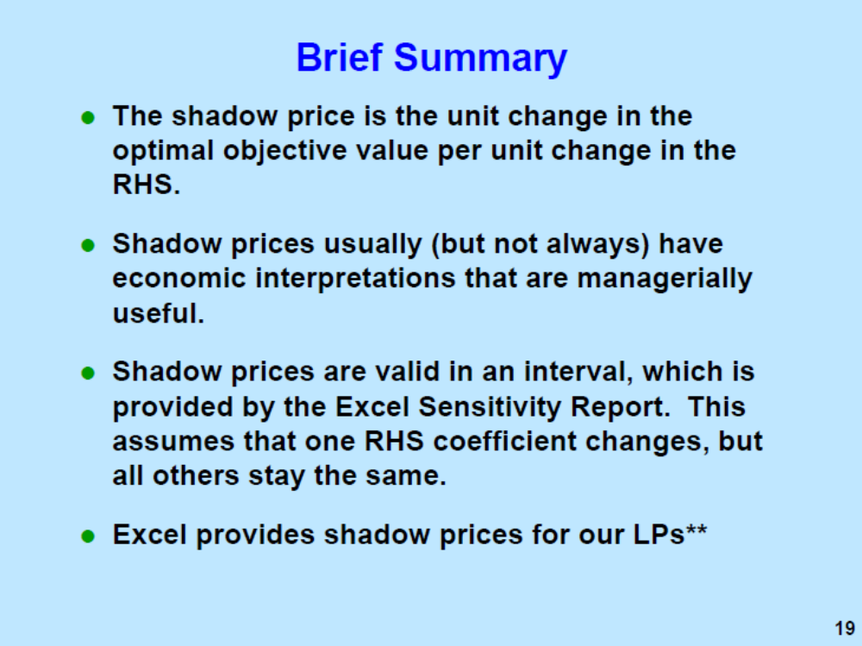

Slide 22
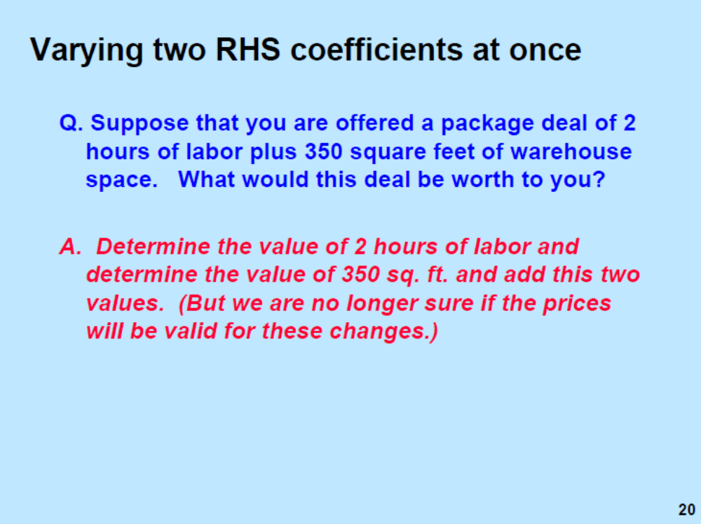

Slide 23
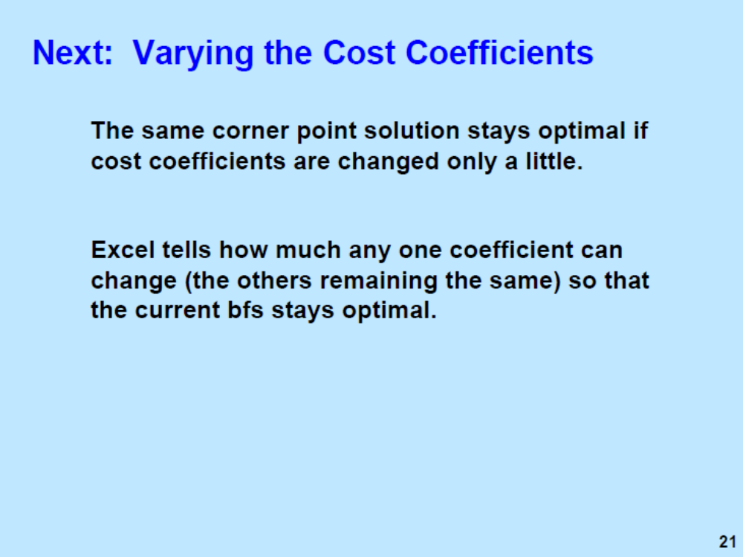

Slide 24
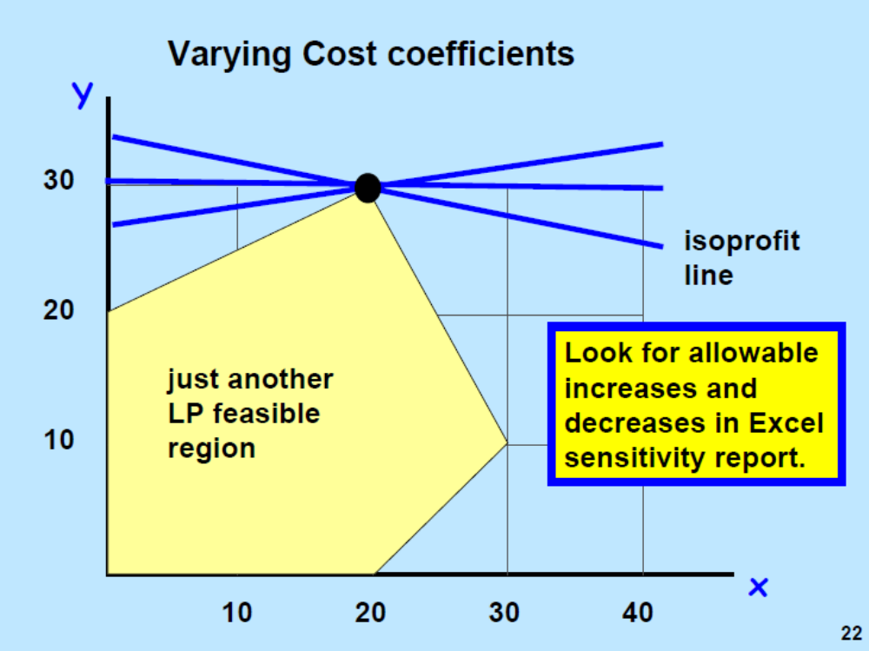

Slide 25
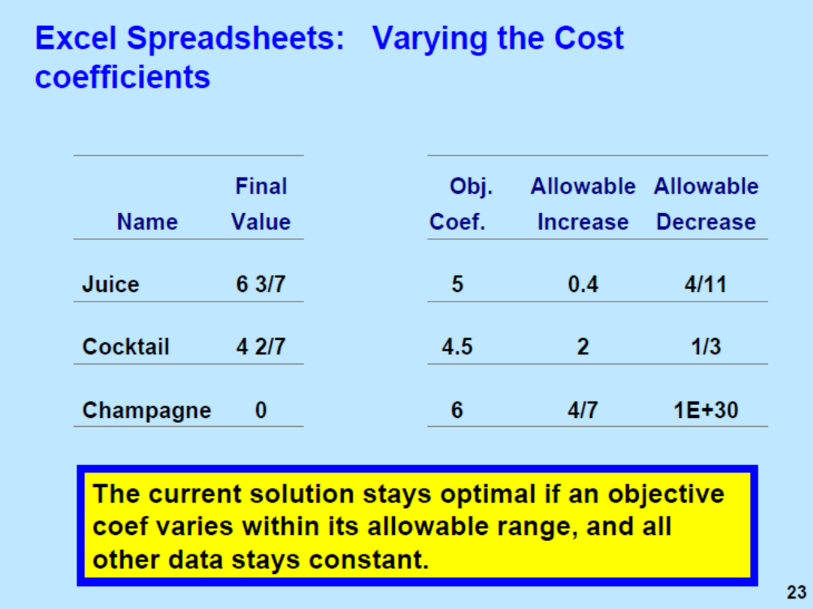

Slide 26
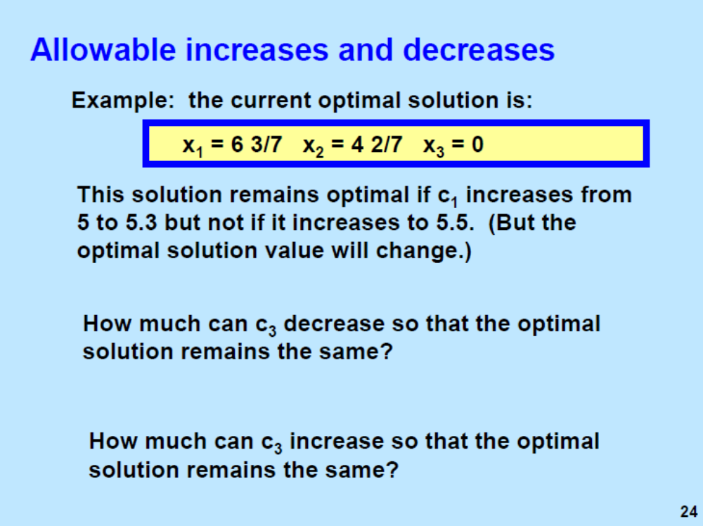

Slide 27
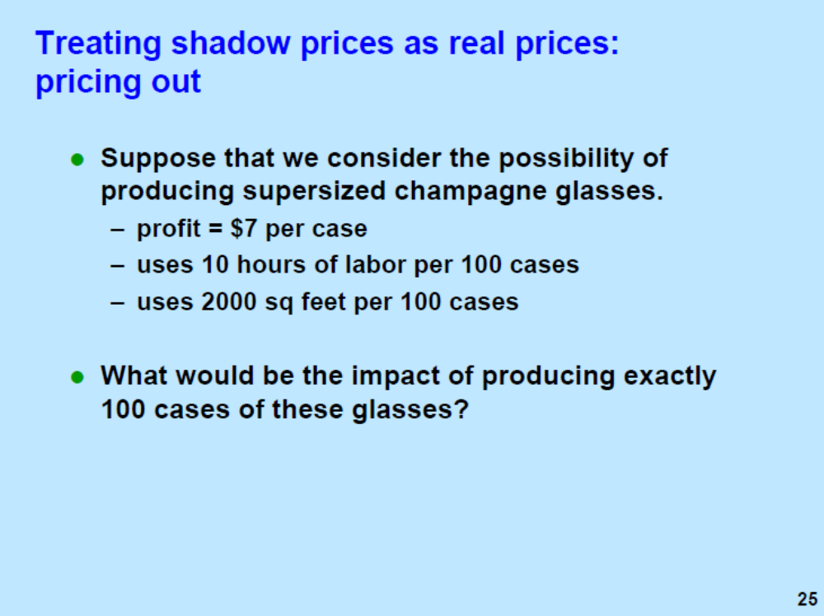

Slide 28
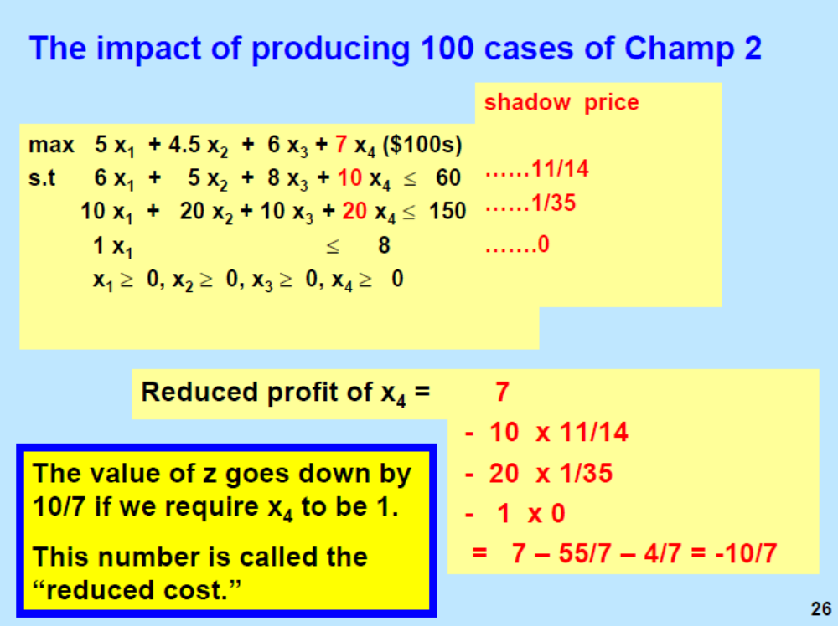

Slide 29
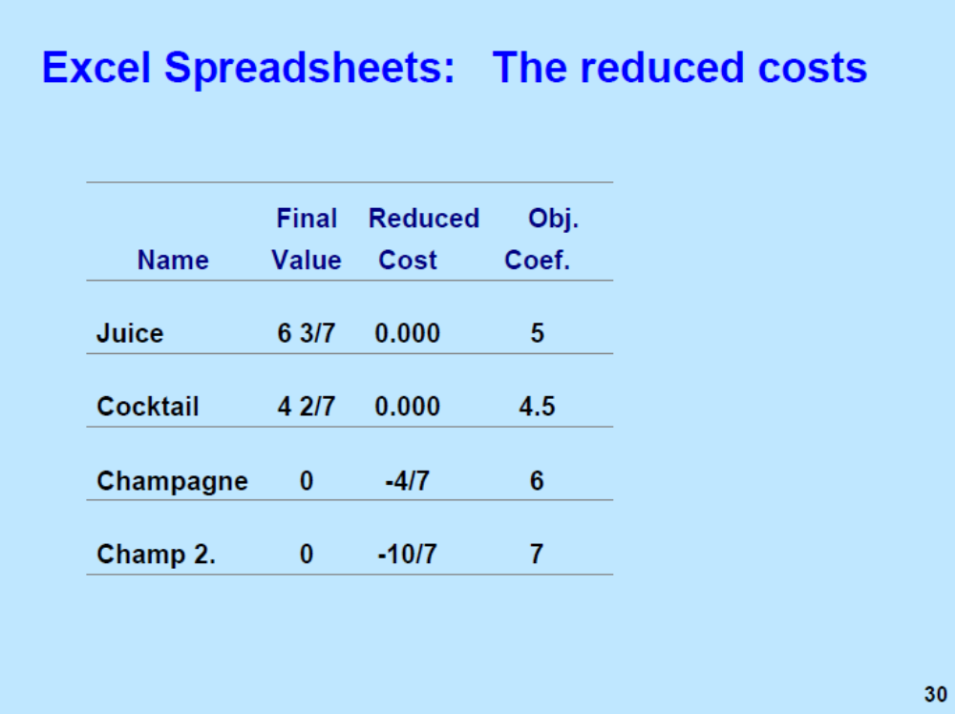

Slide 30
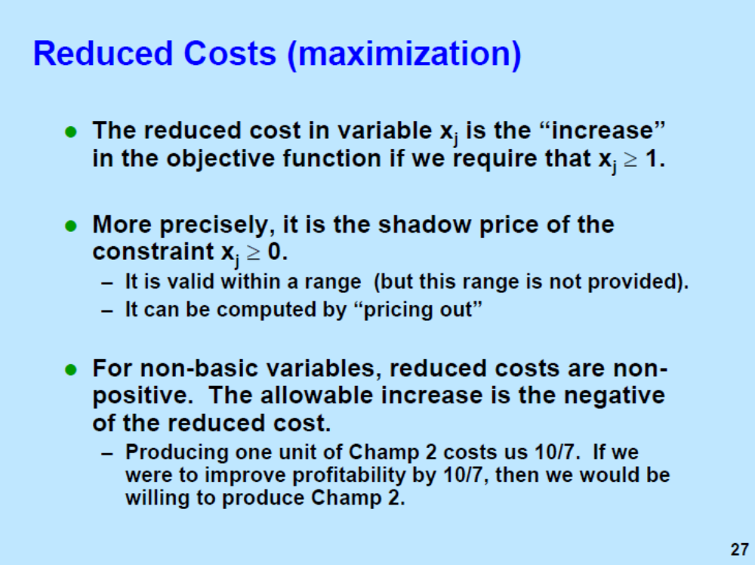

Slide 31
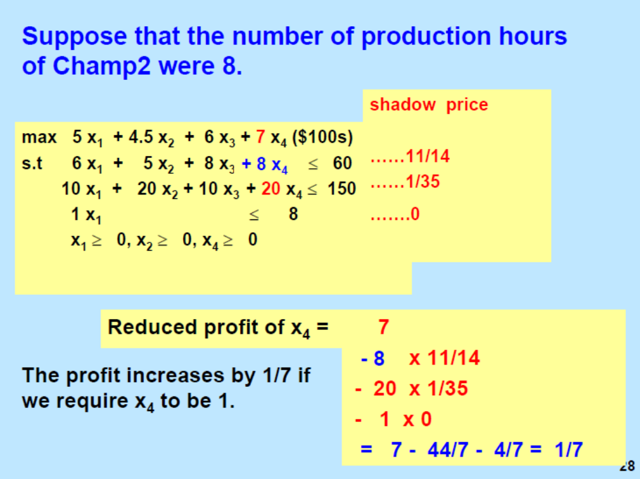

Slide 32
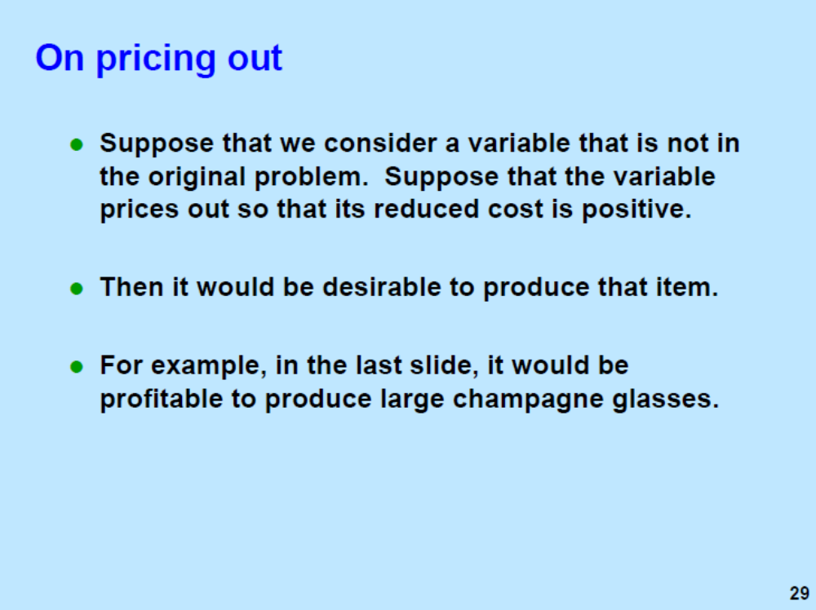

Slide 33
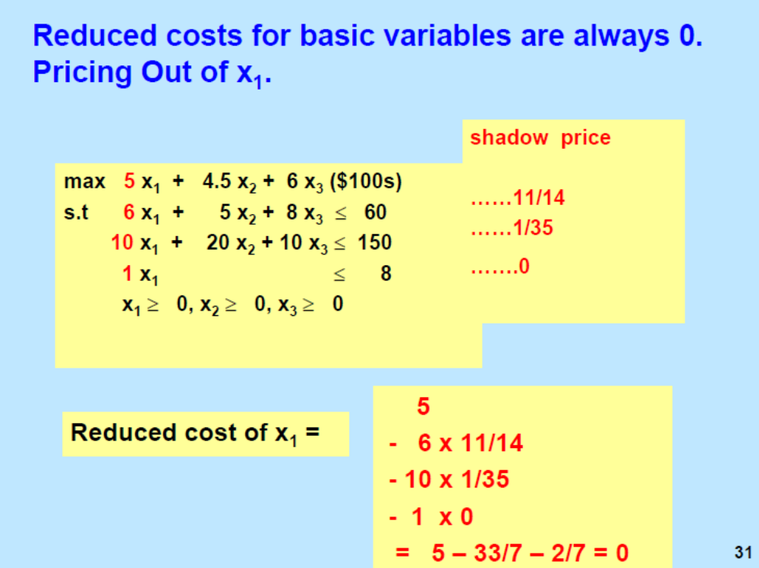

Slide 34
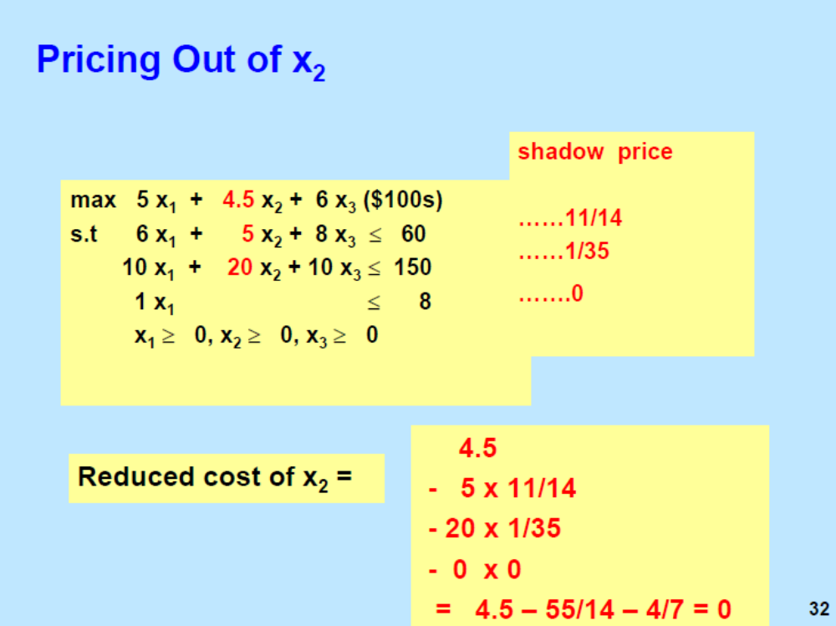

Slide 35
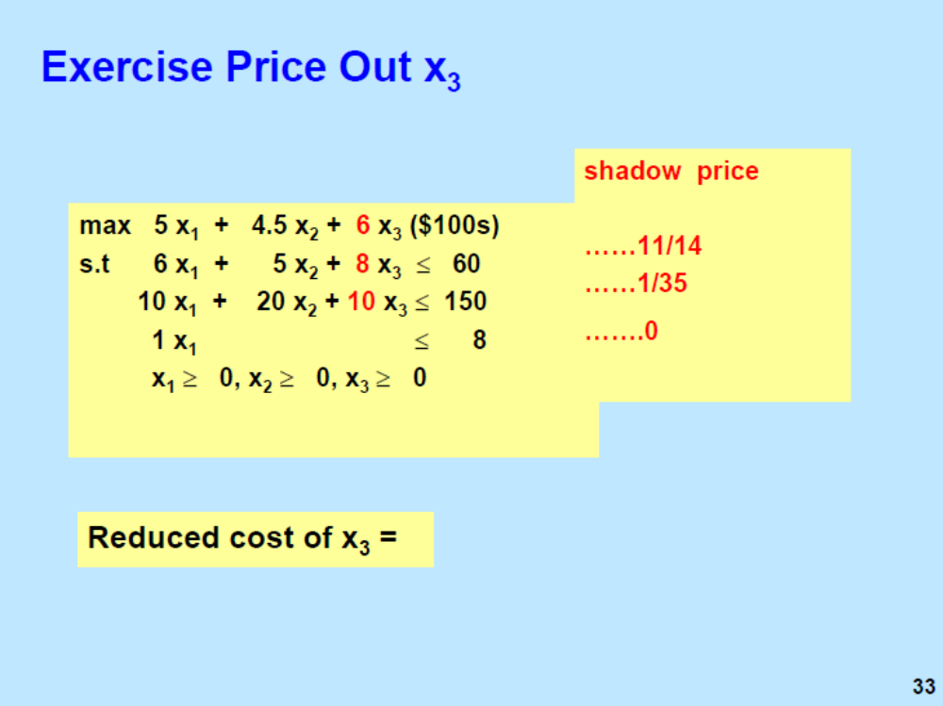

Slide 36
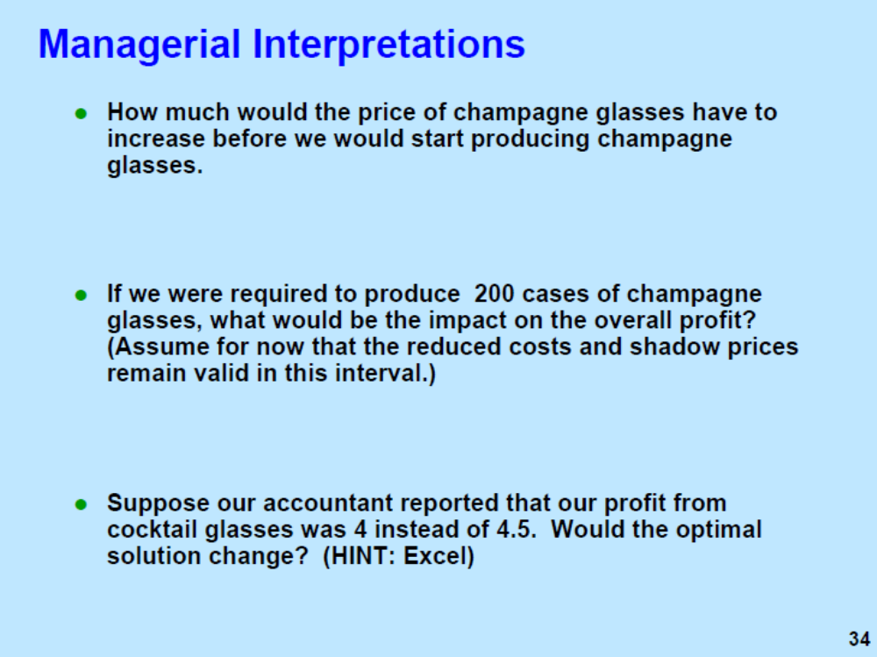

Slide 37
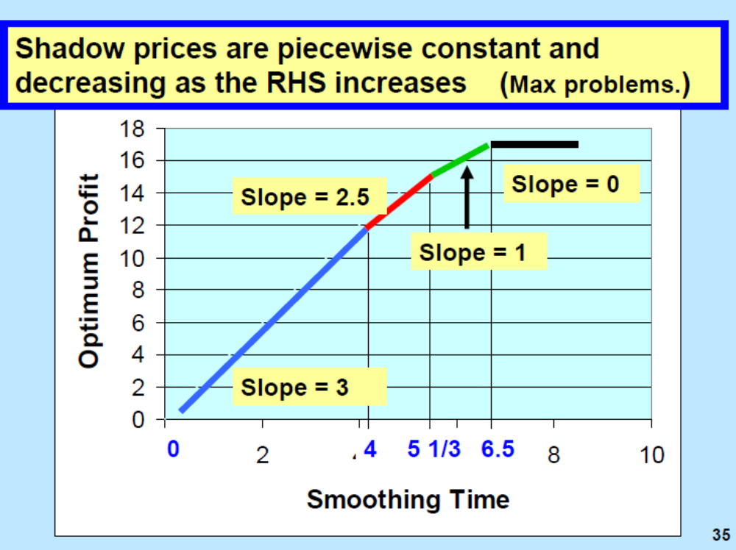

Slide 38
